Slide 1
24MAT120
S2 Mathematics/Physics

Slide 2
Review
  12.5 Lines and Planes in Space 732
  12.6 Cylinders and Quadric Surfaces 740

Slide 3
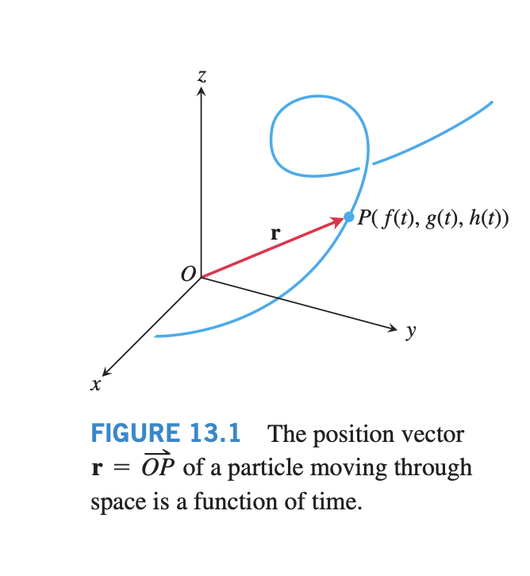

Slide 4
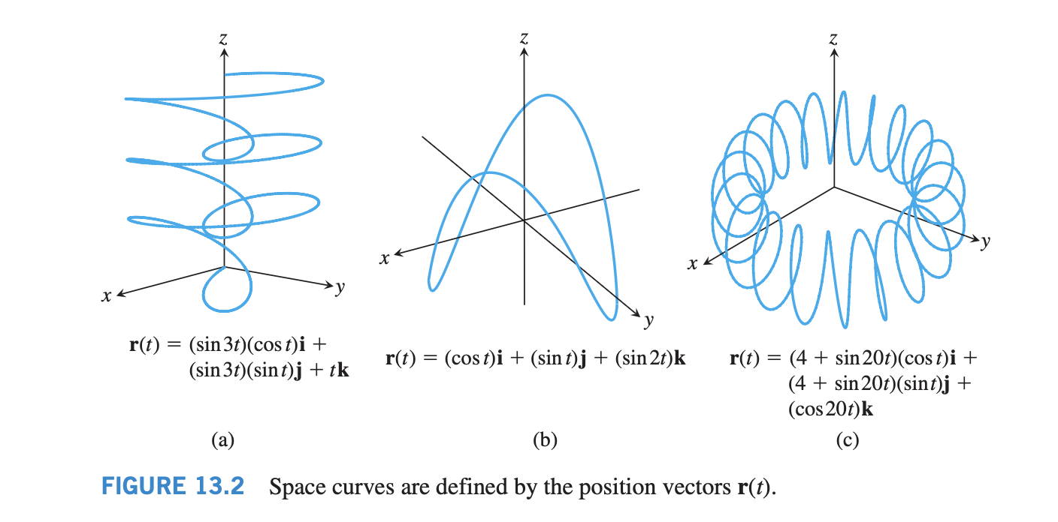

Slide 5
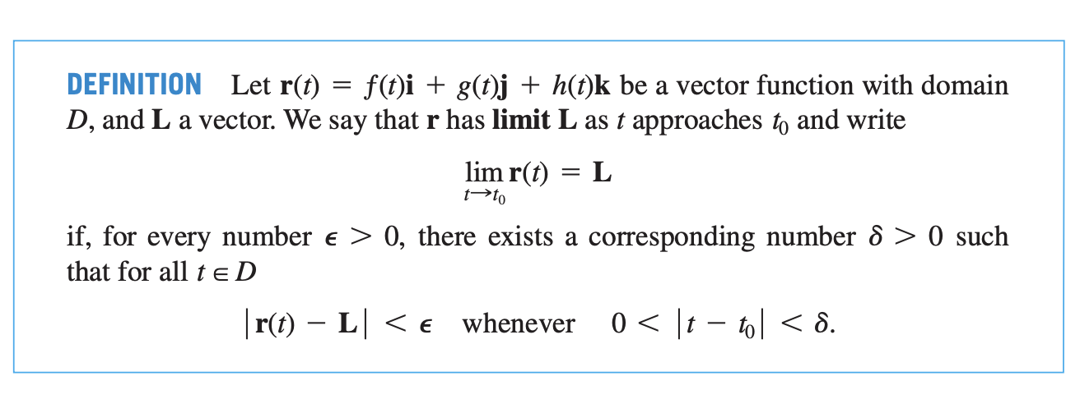

Slide 6


Slide 7


Slide 8


Slide 9
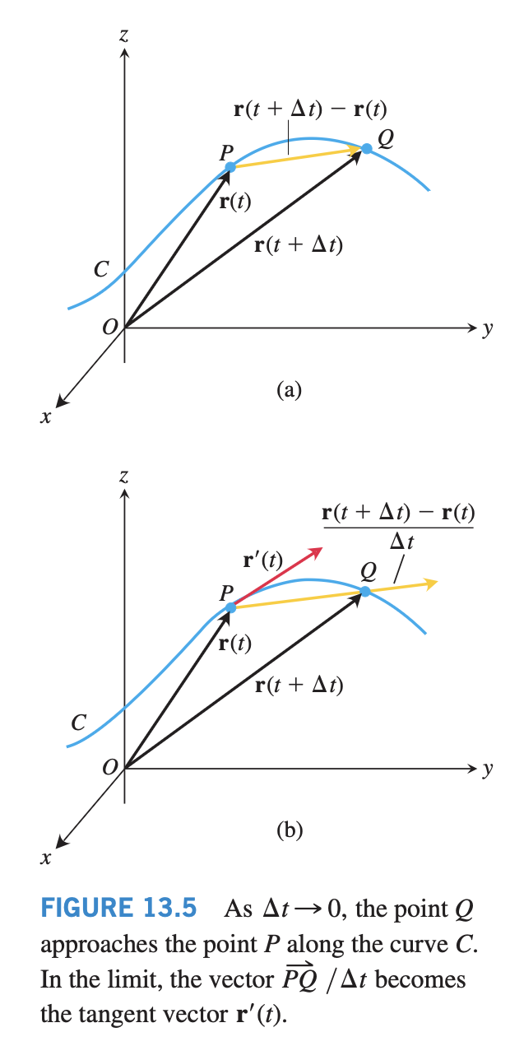

Slide 10


Slide 11
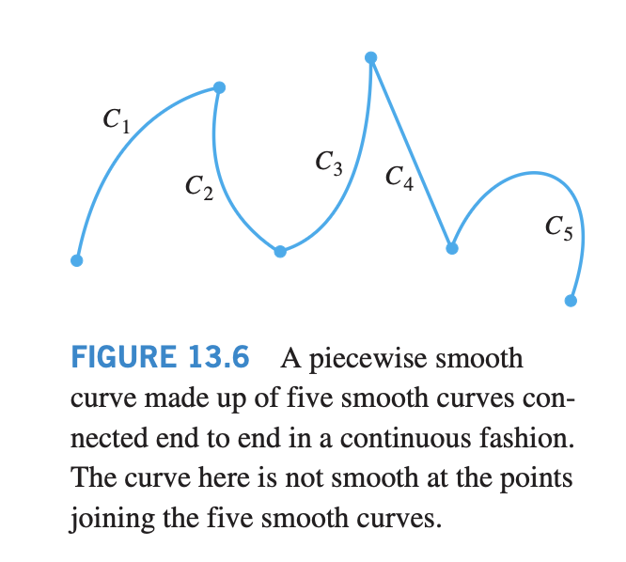

Slide 12
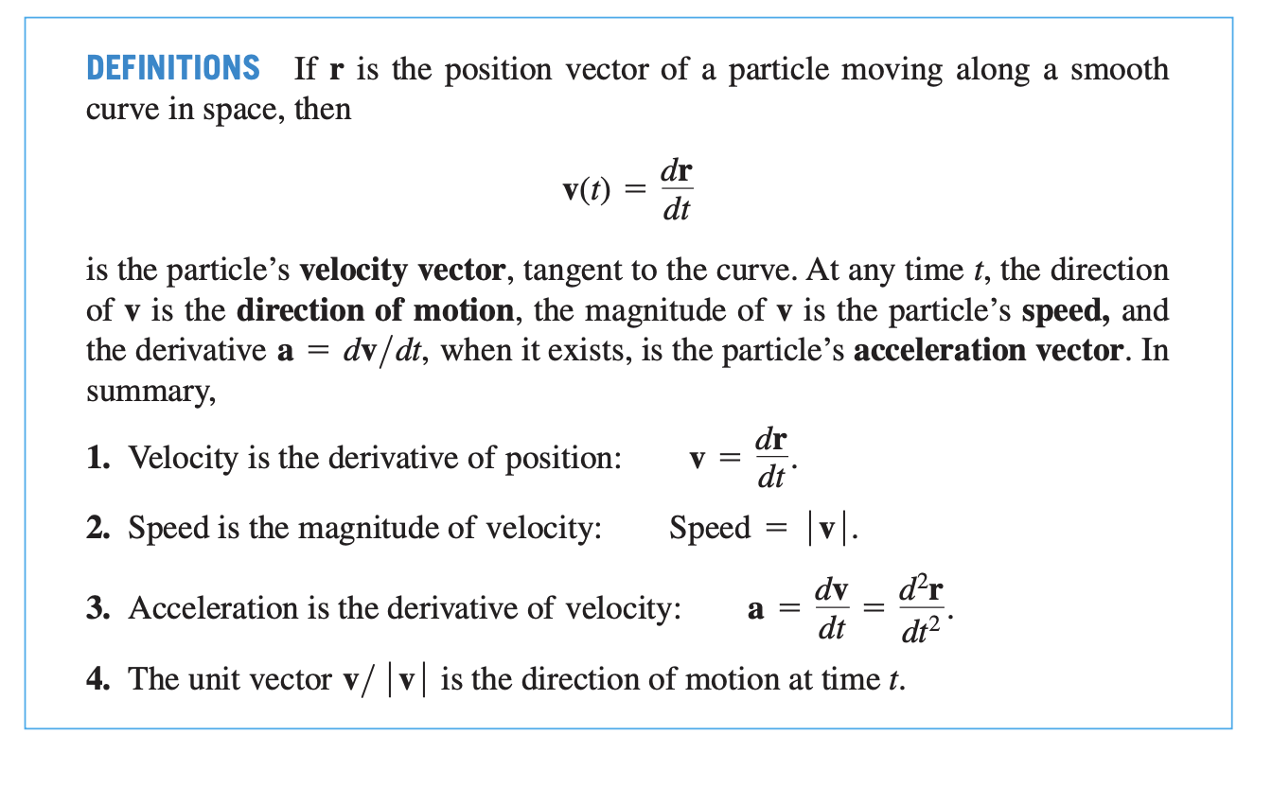

Slide 13

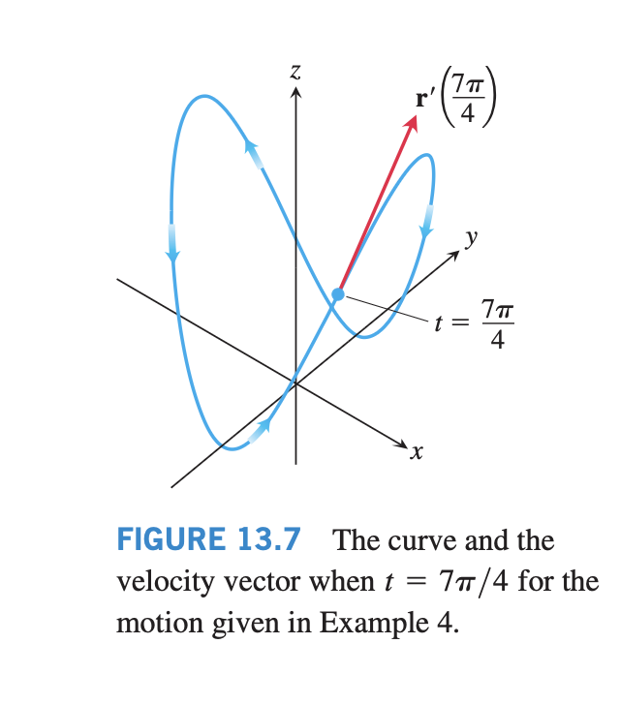

Slide 14
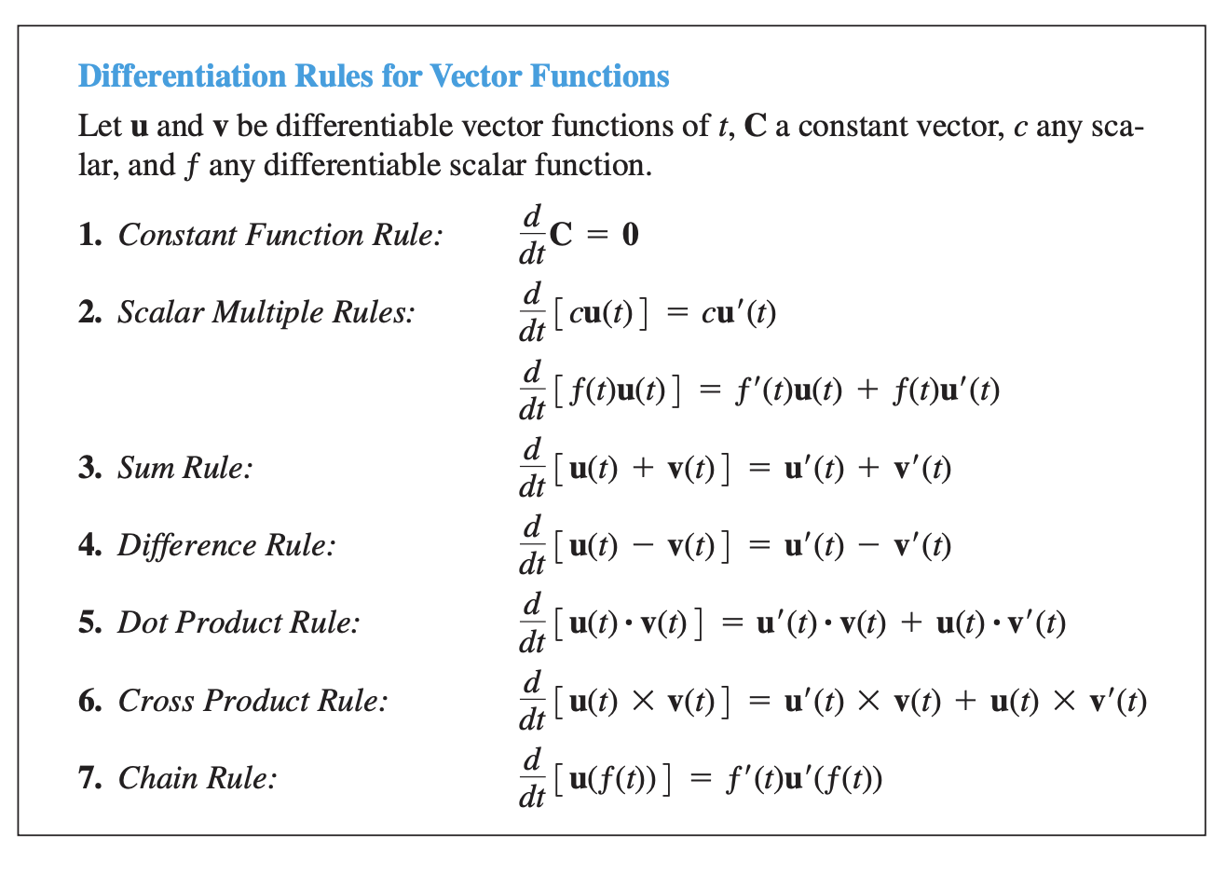

Slide 15


Slide 16
